Slide 1
Software Engineering Day 3 ELITE

Slide 2
Course objectives
On completion of the course, participants will be able to:
Describe software lifecycle
Differentiate between traditional and agile methodologies
Able to write user stories and acceptance criteria
To be able to translate acceptance criteria to test cases
To be aware of the process of configuration management, build and deployment

Slide 3
Introduction to SVN

Slide 4
Open Source Tools
Developer Workbench
Continuous Integration
Configuration Management
Subversion, CVS
Build Management
Maven for Large projects
Ant for Smaller projects
Code Quality
PMD, CheckStyle, FindBugs using Developer IDE
Sonar using Developer IDE and a centralized Sonar Server
LapsePlus – Used for Security Code Review
Unit Testing
Unit Testing
EclEmma (Code Coverage)
eCobertura (Code Coverage)
Continuous Integration
Jenkins
Configuration Management
Subversion
CVS
Project Structure and Build Management
Maven
Code Quality Assessment
Sonar
Test Automation and Execution
JUnit, Selenium, TPTP Test Cases
EMMA for Code Coverage
Defect Tracking
Bugzilla
Testers Workbench
Reusable Components
Test Planning
TPTP for Test Case Suite Management
Test Case Preparation and Execution
Selenium , TPTP, TestNG
WebLoad and JMeter for Load Testing
TPTP for Code Profiling
Defect Tracking
Bugzilla
Exception Handling and Logging
LDAP Integration
Email Integration
Document Management – Jackrabbit
Barcode Generator
Captua Generator
Ehcache + terracotta combination for cache distribution
Image Scanner – Java Applet
Image Viewer – Applet
MQ crusting scripts on Glass Fish Server.
Free lance calendar (supports multiple date formats)

Slide 5
Open Source Tools
Developer Workbench
Configuration Management
Subversion, CVS
Build Management
Maven for Large projects
Ant for Smaller projects
Code Quality
PMD, CheckStyle, FindBugs using Developer IDE
Sonar using Developer IDE and a centralized Sonar Server
LapsePlus – Used for Security Code Review
Unit Testing
Unit Testing
EclEmma (Code Coverage)
eCobertura (Code Coverage)

Slide 6

Introduction To

Slide 7
Subversion
Version Control System : Introduction to Subversion
Version Control Terminologies
Subversion Architecture : An Overview
Subversion Life Cycle/ Workflow
Subversion Repository : An Introduction
Subversion Installation : Eclipse and Subclipse
Configuring Eclipse Project in SVN Repository
Installing and using TortoiseSVN.

Slide 8
Version Control System : Introduction
What is Version Control Good For?
Maintaining project/file history - so you don’t have to worry about it.
Managing collaboration on files and projects - so multiple developers can work
on the same set of files.
Managing releases - so you know what files are in what version.

Slide 9
Version Control System : Introduction
Version control system keeps track of all work and all changes in a set of files, typically
the implementation of a software project, and allows several (potentially widely-
separated) developers to collaborate.
Classification and examples:
Distributed model - Each developer works directly with their own local repository, and
changes are shared between positories as a separate step.
Open-source : GNU arch, Bazaar
Proprietary : BitKeeper, Code co-op, TeamWare
Client-server model - developers use a shared single repository.
Local only : Revision Control System (RCS)
Open-source : CVS, CVSNT, OpenCVS, Subversion, Vesta
Proprietary : a lot

Slide 10
Version Control System : Goals
Maintain history of every version of everything
Do not overwrite each other’s changes
Allow developers to work simultaneously
A version control system is a place to store all the various revisions of the stuff you write while developing an application.

Slide 11
Version Control System : Categories
Version Control System
Centralized Version Control System (CVCS)
Distributed/Decentralized Version Control System (DVCS)
Subversion falls under centralized version control system as it uses central
server to store all files and enables team collaboration.
"Subversion is version control: the art of managing changes to information."

Slide 12
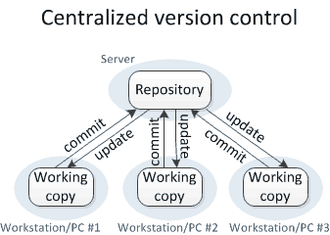
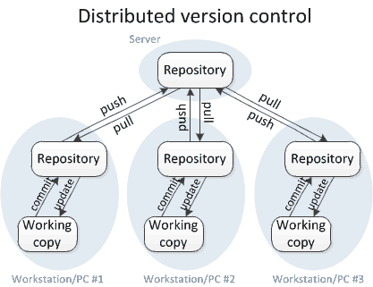
Version Control System : Categories
Concurrent Version System(CVS)
SubVersion
Git Hub
Mercurial

Slide 13
Version Control System : SubVersion
Subversion is a free/open source version control system (VCS) to manages
files and directories, and the changes made to them, over time.
Subversion allows to recover older versions of the data or examine the history of how
your data changed.
Founded in 2000 by CollabNet, it is functional replacement for CVS(Concurrent Versions
System).
SVN is an open source software tool, which acts as a server repository for storing and
managing the files and directories.
It is used to checkout, update, delete, export and import changes done on the modules
in to the server repository.
Current version: 1.8.13 / 2015-03-31

Slide 14
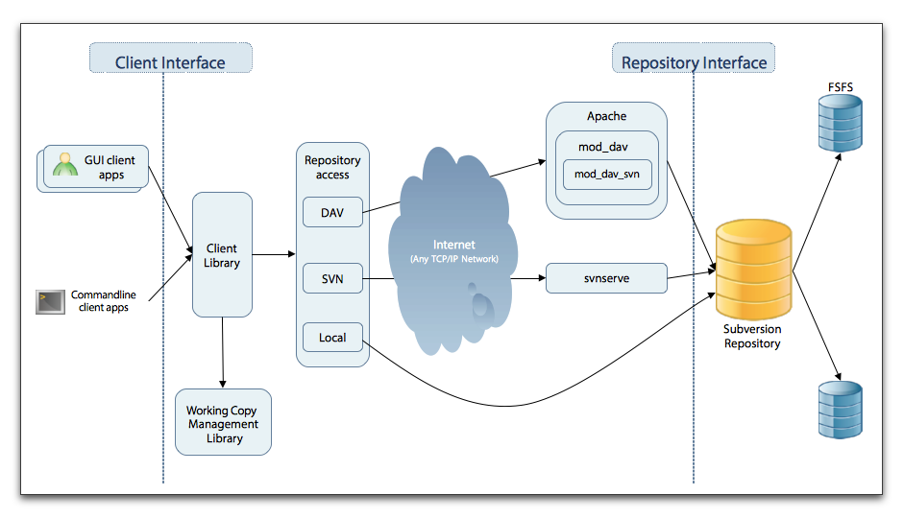
SubVersion Control System : Architecture
Source : NobleProg Trainers Material

Slide 15
SubVersion Control System : Terminologies
Repository
It is the central place where developers store all their work.
Trunk
The trunk is a directory where all the main development happens and is usually checked out by developers to work on the project.
Tags
The tags directory is used to store named snapshots of the project.
Branches
Working copy
Branch operation is used to create another line of development.
Working copy is a snapshot of the repository.
Commit changes
Commit is a process of storing changes from private workplace to central server.

Slide 16
SubVersion Control System : Components
SVN Components
Client Component
Tortoise SVN
Collabnet
Server Component
Collabnet
Visual SVN
Visual SVN
Server and Client Component Providers
The client is the browser that accesses the data on the server.
The server manages the central master copy of your projects in a database that is
referred to as the "repository".

Slide 17
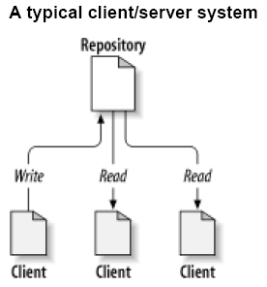
SubVersion Control System : Main Concepts
The Repository
Subversion is a centralized system for sharing information.
At its core is a repository, which is a central store of data.
Can be accessed via a HTTP or HTTPS connection.
Repository remembers every change ever written to it:
every change to every file, and even changes to the directory tree itself, such as
the addition, deletion, and rearrangement of files and directories.

Slide 18
SubVersion Control System : Main Concepts
Working Copy
A Subversion working copy is an ordinary directory tree on local system,
containing a collection of files.
Subversion provides commands to commit your changes and merge other
people changes into your working copy.
Each working directory has a .svn directory (administrative directory)
Repository password are stored in each .svn folder.
Stores a original copy of each file in directory

Slide 19
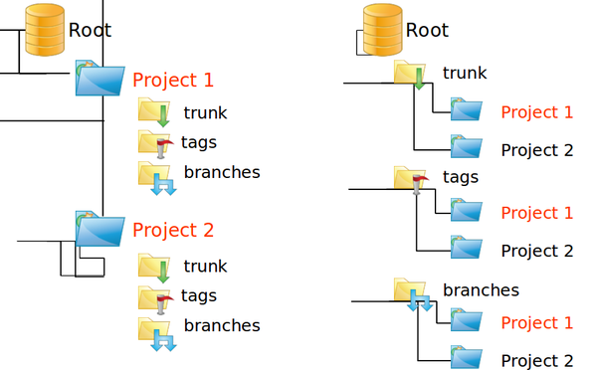
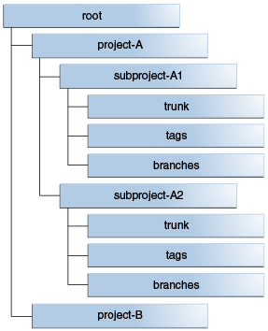
SubVersion Control System : Repository Hierarchy
Source : NobleProg Trainers Material

Slide 20
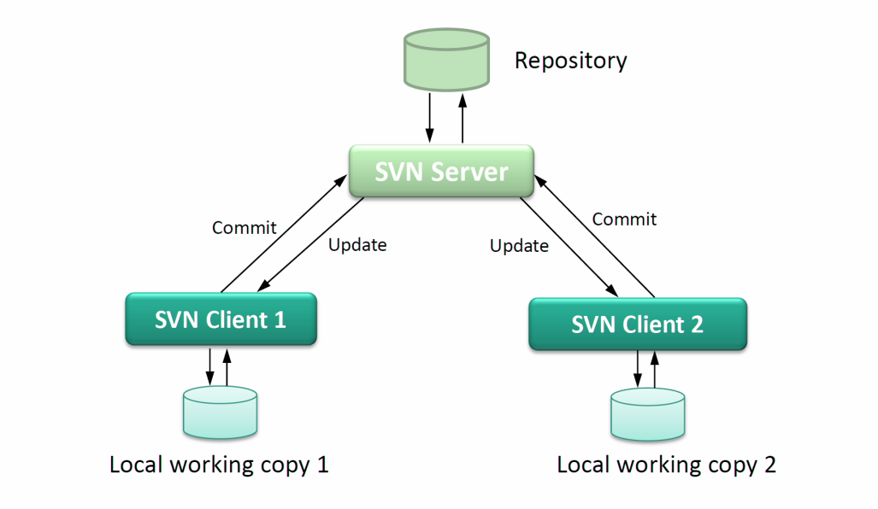
SubVersion Control System : Work Flow
Get a working copy
Make changes in your copy
Test them locally
Integrate them with any changes made to the Repository
Commit them back to the Repository
Repeat these steps until a release is ready
Tag the release
Start making changes again for next release

Slide 21
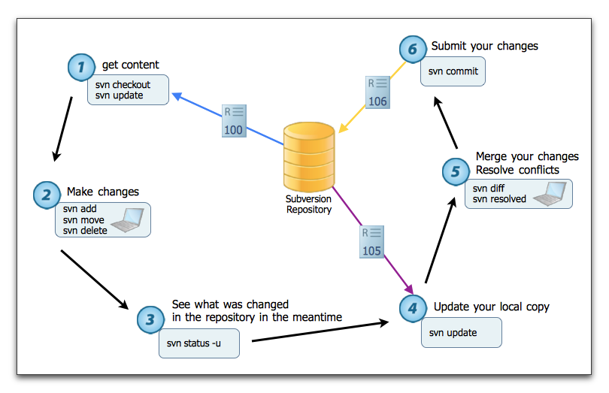
SubVersion Control System : Work Flow

Slide 22
SubVersion Control System : Getting Started
Subversion client is distributed as command-line tool and can be downloaded at:
http://subversion.tigris.org
Another one choice - Tortoise SVN, a Subversion client, implemented as a windows
shell extension:
http://tortoisesvn.tigris.org/
For development more convenient is to use Subclipse plug-in for Eclipse. Subclipse
can be installed and updated from within Eclipse:
http://subclipse.tigris.org/install.html

Slide 23
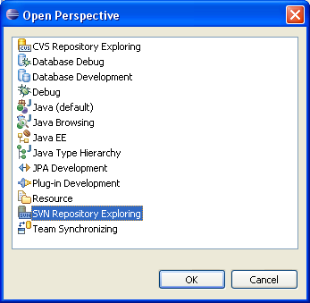
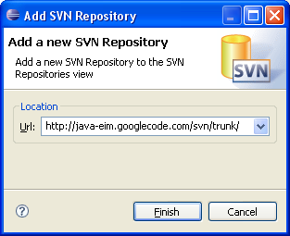
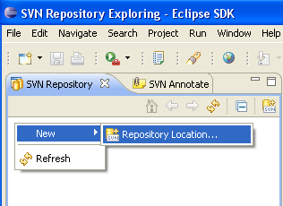
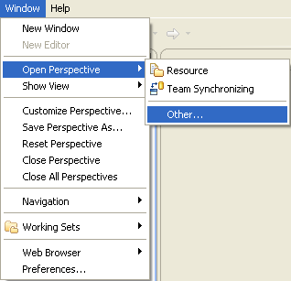
SubVersion Control System : Using Subclipse
In Eclipse switch to “SVN Repository Exploring” perspective and create new
Repository Location.
Type repository URL, e.g.
http://java-eim.googlecode.com/svn/trunk/

Slide 24
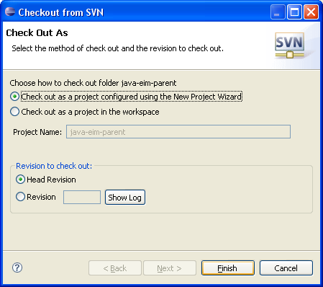
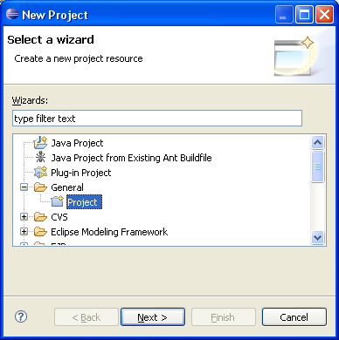
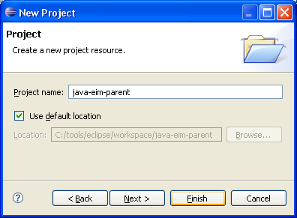
SubVersion Control System : Using Subclipse
Check-out the project
A check-out creates a local working copy from the repository.
Right-click on a module for check-out, choose “Checkout…” option
Choose to check-out using e.g. New Project Wizard
Check-out e.g. as General → Project

Slide 25
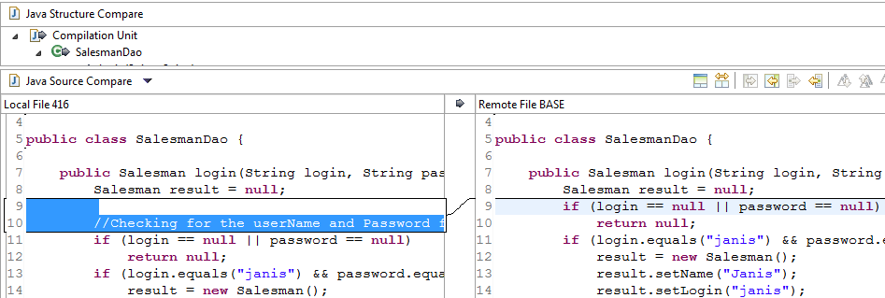
SubVersion Control System : Using Subclipse
Make changes and commit
A commit (check-in) occurs when a copy of the changes made to the working copy is written or merged into the repository.
Switch to another perspective, for example, “Java”
View and modify files in your working copy.
When finished and ready to commit certainly(!!!) synchronize with repository, to avoid conflicting changes (probably somebody already modified the same files)!!! Right click → Team… → Synchronize with Repository
To compare local and remote files double click on file.

Slide 26
Important References…
http://subclipse.tigris.org/
http://svnbook.red-bean.com/en/1.7/index.html
https://svn.apache.org/repos/asf/subversion/trunk/notes/subversion-design.html
https://docs.oracle.com/middleware/1213/core/MAVEN/config_svn.htm#MAVEN8820
http://subversion.tigris.org/
http://subclipse.tigris.org/wiki/RepositoryProviders

Slide 27
Elements of DevOps (Afternoon Session –Self learning)
Please go through eLearning Module in ilearn of 3 hrs duration)
https://sumtotal.techmahindra.com/sumtotal/app/management/LMS_LearnerHome.aspx
Search for SS0743

Slide 28
Thank you Prakash.LNS@TechMahindra.com

